Slide 1
Automatic Voice Recognition
Yuannan Cai
Wenyu Zhang
Zhilei Miao

Slide 2
Project Goal
In this project, we hope to build a human voice recognition system in a voice message application to tell who is currently speaking. Users can also read and tell who is speaking from is visualized information panel on a web page. We will build a web page displaying the list of participants and current speaker will be marked. The audio sample messages will be collected by App on mobile devices. It is useful in an IoT application system, where people talk to devices but we need to know who is speaking.

Slide 3
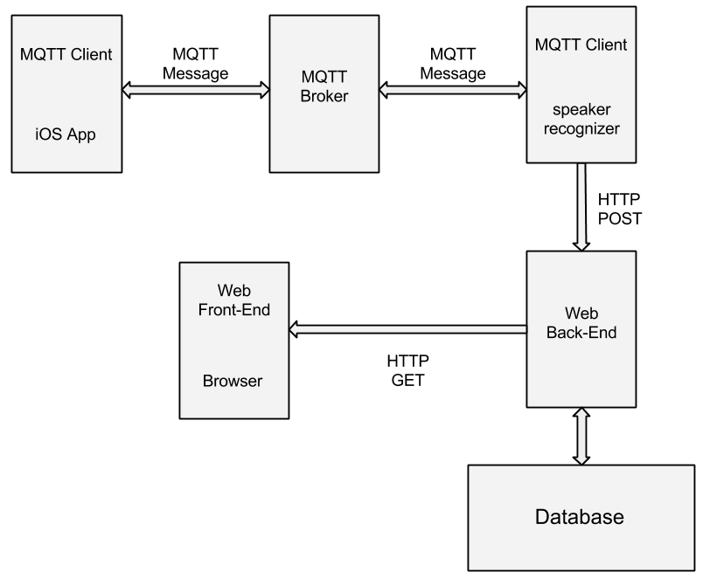
Project Structure

Slide 4
Web Back-end
Back-end is implemented with two RESTful APIs: GET and POST
GET: Front-end use GET to access to user information including: userID, username and time.
Example: GET request format could be:
http://localhost:8080/test?offset=1&limit=5
Which will return the information of 5 users from the user with ID 1.
POST: The sever receive recognition result from MQTT client and store the new user information in the database using JDBC.

Slide 5
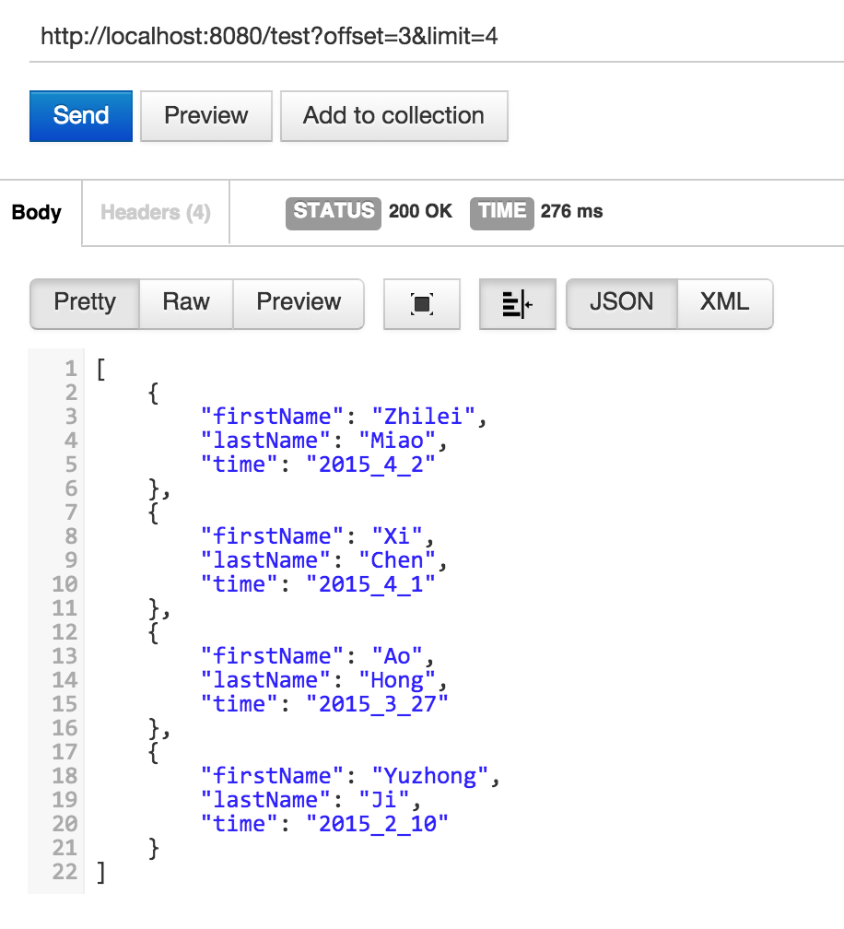
Web Front-end
As shown in the example, the front-end use HTTP GET request to access the user information in sever, the information is returned in JSON format.
Front-end will show a list of users and mark the user who is currently speaking or who spoke most recently

Slide 6
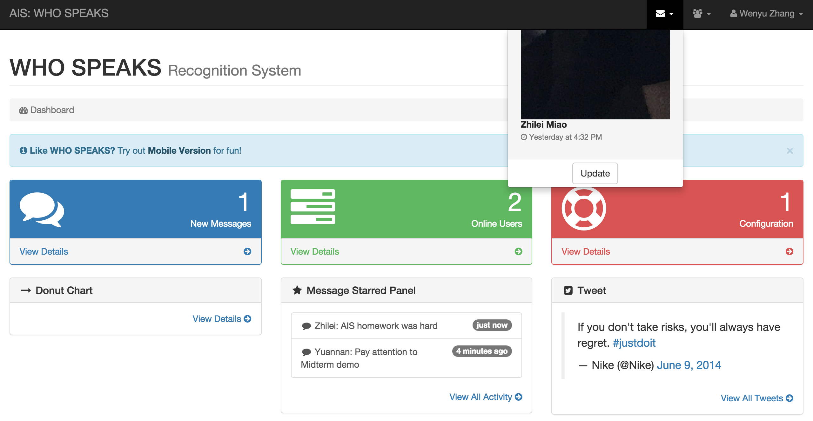
Web Front-end
Currently, the user can use the update button to update the user list to see if there is anything changed since the last updating. Also,the page will also inform there are new messages .

Slide 7
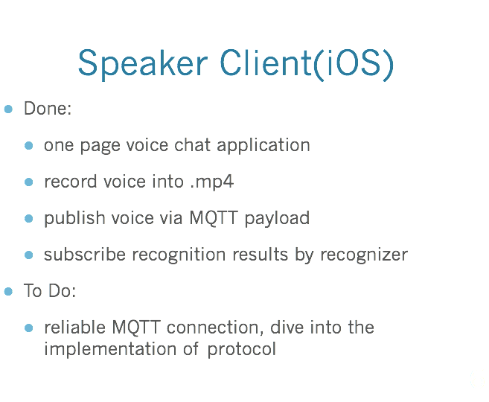

Slide 8
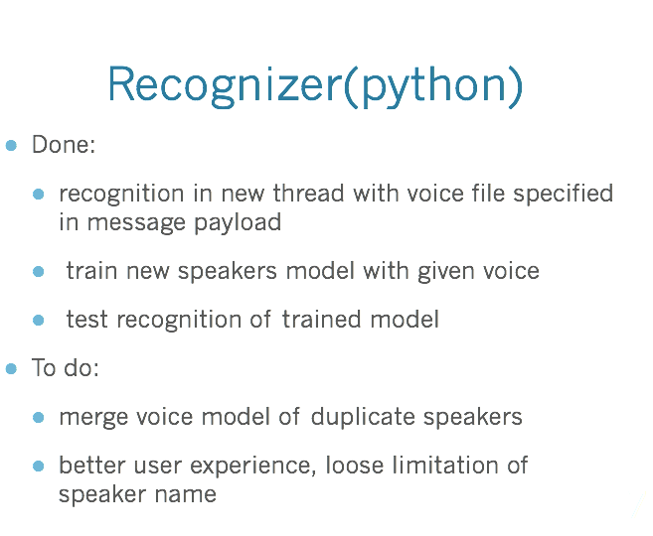

Slide 9
Demo time

